Slide 1

THE MICROSOFT
DevOps Story
WITH VSTS
Jason Poon (@jasonthepoon) Software Engineer, Microsoft
Notes:
When I first joined MSFT in 2010
Boxed Products to Cloud+Mobile First

Slide 2
AGENDA
01
Traditional Development And Deployment
02
What is DevOps?
03
How to DevOps
04
Microsoft’s DevOps Solution
Notes:
Demo gods

Slide 3
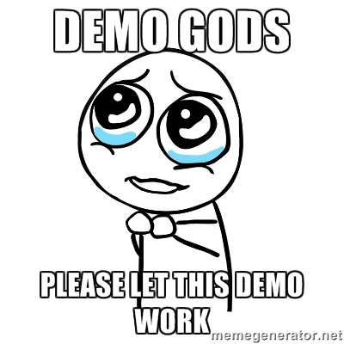

Slide 4
01
B
D
D
BEAUCRATIC DRIVEN DEVELOPMENT
Notes:
Internal API Access – Needed to Open a Ticket
Scale Up My Machine – Open a Ticket
Wanted to Deploy a Change – Open a TIcket

Slide 5



TRADITIONAL DEVELOPMENT
Dev
Test
Ops
PM
Notes:
4 Distinct Roles: PM – Talks to customers, figures out what to build. Virtual Assistant => Benji
Dev – Prepares a software release
Test – verifies behavior. We had test environments: Func, Test, Int
Ops – Deploys release artifacts to Prod
Deployment Document
Differences in priority:
Dev/Test = Make sure it behaves properly
Ops = 100% uptime. Restart machine -> erasing crime scene
When things break, blame game.

Slide 6
?
Frustration
Delays
Lack of Insights
Notes:
Frustration with all parties due to a lack of collaboration and communication
Leads to increased time and labor involved in delivery and maintaining software systems
Exacerbate that problem, much of what we built was based on assumptions instead of hard data that could easily lead to the team building the wrong thing.
The inability to deliver software efficiently and react quickly to changes can lead to much more than just frustration –in the long run, this can threaten your entire business!

Slide 7
02
WHAT IS DEVOPS?

Slide 8
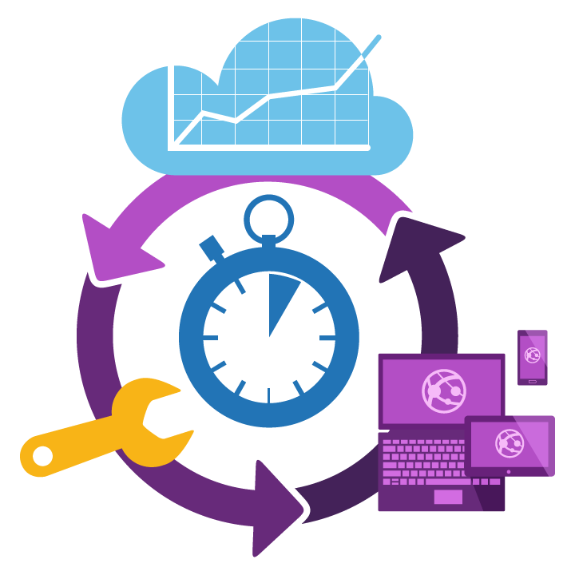
WHAT IS DEVOPS?
/dɪˈvɒpːˈɛs/ Noun a cross-disciplinary community of practices dedicated to the study of building, evolving and operating rapidly-changing resilient systems at scale.
Notes:
Carefully crafted corporate definition
it’s not a product that you buy and install to fix everything that is wrong or broken with software development.
DevOps is a term for a group of concepts that, while not all new, have catalyzed into a movement in the technical community.
Set of tools and patterns to help ship high quality software quicker

Slide 9
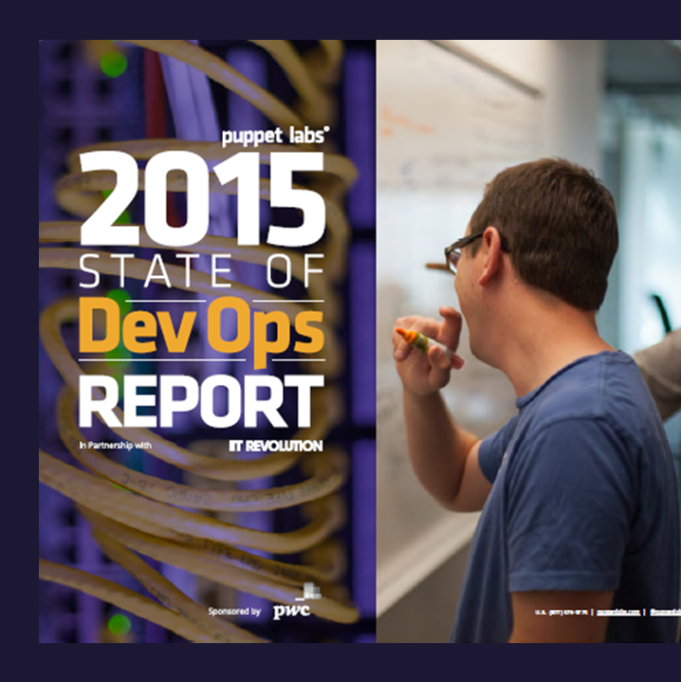
DEVOPS BENEFITS
Competitive advantage
Deploy code 200x times
Firms with high-performing IT organizations were 2x as likely to exceed their profitability, market share, and productivity goals
with 2555x faster lead times compared to lower-performing peers
2016
3x lower failure rate
Improved code quality
and 24x faster mean time to recover (MTTR)
22% less time on unplanned work and rework
Source: https://puppetlabs.com/
Notes:
Deploy Code Faster
WinStore -> 3 months to 1 month
Code Failures
Improved Code Quality
Shift Left. Instead of testing quality at end, multiple feedback loops along the way to ensure quality

Slide 10
03
IMPLEMENTING DEVOPS

Slide 11




THE DEVOPS CONVERSATION
People
Process
Tools
Notes:
People/culture is about bringing people together in a collaborative fashion that enables multi-discipline teams to work together more easily, share common goals, and focus on identifying new areas for improvement.
Merger of Dev/Test, Expansion of Dev roles
Process is about finding ways to increase efficiency, streamline feedback and eliminate waste. All processes should be focused on delivering business value faster - focusing on the flow of value through the system.
As organizations become better at delivering value, they should be implementing feedback loops to get feedback from customers, and they should begin to experiment continuously to improve their value delivery.
Continuous Integration/Deployment
Tools support processes and help people collaborate - delivering software faster, facilitate feedback and experimentation.

Slide 12
PEOPLE @ MICROSOFT
PM
Dev
Test
Ops

Slide 13
04
DEVOPS AT MICROSOFT WITH VISUAL STUDIO TEAM SERVICES

Slide 14




THE DEVOPS LIFECYCLE
1
4
Plan
Monitor + Learn
Development
Production
2
3
Develop + Test
Release
Notes:
Visual Studio Team Services which help with all these stages

Slide 15
PLAN
It starts with an idea – and a plan how to turn this idea into reality
Project starts
Manage work
DEVELOP+TEST
1
Track progress
Plan
Notes:
It starts with an idea – and a plan how to turn this idea into reality
Planning, managing and tracking work is a joint exercise between Dev and Ops facilitated by a single, unified backlog

Slide 16
DEMO
Plan
Notes:
Let me show you a few of the things we have been working on

Slide 17
DEVELOP+TEST
2
Once the iteration starts, developers turn great ideas into features
Write Code
Unit Testing
Version Control
Build
Build Verification
RELEASE
Notes:
Once the iteration starts, developers do what they do best – turn great ideas into reality
Today, no developer works alone – they are part of a team and need to collaborate to create truly outstanding work
While speed is key, quality is equally important – a quality-first mindset must drive everything the team does, it does not help if you deliver fast if the result does not work

Slide 18
DEMO
Develop + Test

Slide 19
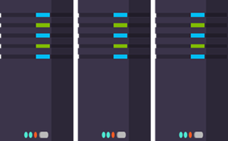
RELEASE
When all tests pass, the build is deployed to testing environments for each stage in the release process
Cloud Load Testing
Integration testing
environment
Staging
environment
3
MONITOR + LEARN
Automated functional testing environment
Pre-production environment
Notes:
When a build passes all initial tests, it’s release time
Releasing software does not need to be scary or stressful
Continuous and automated testing ensures that your app does what it is supposed to do and matches user expectations
Self-service, on-demand environment provisioning and automation takes the headaches out of dealing with dev/test infrastructure
Every deployment works exactly the same way every time and transparency and control guarantee full traceability and visibility into each step of the process

Slide 20
DEMO
Release
Notes:
* Package Management: Nuget, npm, maven

Slide 21
PLAN
MONITOR+LEARN
Learn and understand how users use your app, how it performs and quickly fix issues and bugs
Feedback
Monitor
4
Notes:
The app has been released to production and the iteration is done, but work is not over!
With your app being used by real users, now is an ideal opportunity to collect data and evidence that helps you prioritize your backlog based on hard data instead of assumptions
It’s easy to instrument your app and get ambient monitoring out of the box, with almost zero effort
This way, you can get a 360° view of your application that includes availability and performance as well as user behavior – a single pane of glass for your application

Slide 22
DEMO
Application Insights

Slide 23





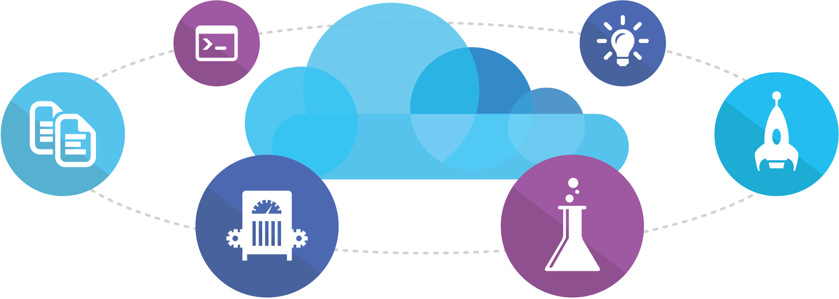
Microsoft Ecosystem
People | Process | Tools
01
02
03
Developer Workstation
Build/CI
04
Release
Develop
Monitor
Build & Test
Visual Studio
Team Services
Deploy
Test
Release Management for Visual Studio
Team Collaboration
Monitor & Learn
Automation Service
Visual Studio
Team Services
Visual Studio
Team Services
PowerShell | WAML
Application Insights
Azure Resource Management
Package Manager
TFS
DEV
TEST
QA
Workstations - On-Premises | Hybrid | Cloud
Services - On-Premises | Hybrid | Cloud
Environments - On-Premises | Hybrid | Cloud
Monitoring - On-Premises | Hybrid | Cloud
Notes:
VSTS is an all-in-one shop

Slide 24












Mixed Ecosystem
People | Process | Tools
01
02
03
Developer Workstation
Build/CI
04
Configuration
Develop
Monitor
Build & Test
Deploy
Team Collaboration
Release
Monitor & Learn
Test
This graphic shows OSS and partner products that are integrated with the Microsoft DevOps solution

Slide 25

IN REVIEW
OLD WORLD
Focus on planning
Compete, not collaborate
Static hierarchies
Assumptions, not data
NEW WORLD
Focus on delivering
Collaborate to win
Fluid and flexible teams
Experiment, learn and respond
Notes:
Not the car not the driver ... The pit crew wins the race
Multi-skill across organization. Generalists

Slide 26
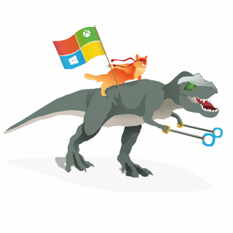



RESOURCES
Visual Studio Team Services (VSTS) www.visualstudio.com/
Microsoft’s DevOps Journey http://stories.visualstudio.com/devops/
Puppet Labs 2016 State of DevOps Report https://puppet.com/resources/white-paper/2016-state-of-devops-report
Microsoft Azure https://azure.microsoft.com/
DevOps Self Assessment http://devopsassessment.azurewebsites.net/
Jason Poon github.com/jpoon
@jasonthepoon
jason.poon@microsoft.com

